Slide 1
Lecture 12: Array and Vector – Part II
Class page: https://github.com/tsung-wei-huang/cs1410-40
Dr. Tsung-Wei Huang
Department of Electrical and Computer Engineering
University of Utah, Salt Lake City, UT

Slide 2
Announcement
First midterm on 10/12 starting at the class time
Concept + Programming questions whatever we’ve covered
Due on 23:59 PM 10/18 (Sunday)
No lectures or Lab on the midterm week, but
We will have extra office hours at the scheduled class/lab time
We will help clarity your questions rather than give you solutions
Midterm will be take-home exam
Free to find solutions using the internet resource
Free to discuss solutions with your friends
NEVER JUST COPY SOLUTIONS
You can’t violate the rules of academic integrity
You are already undergraduates, be mature and responsible
Ultimately, it is your own knowledge, not mine

Slide 3
Array
An array is a consecutive group of memory locations that all have the same type.
To refer to a particular location or element in the array, specify the name of the array and the position number of that element.
The position number is formally called a subscript or index.
This number specifies the number of elements from the beginning of the array.
A subscript must be an integer or integer expression (using any integral type).
The first element in every array has subscript 0 (zero) and is sometimes called the zeroth element.

Slide 4
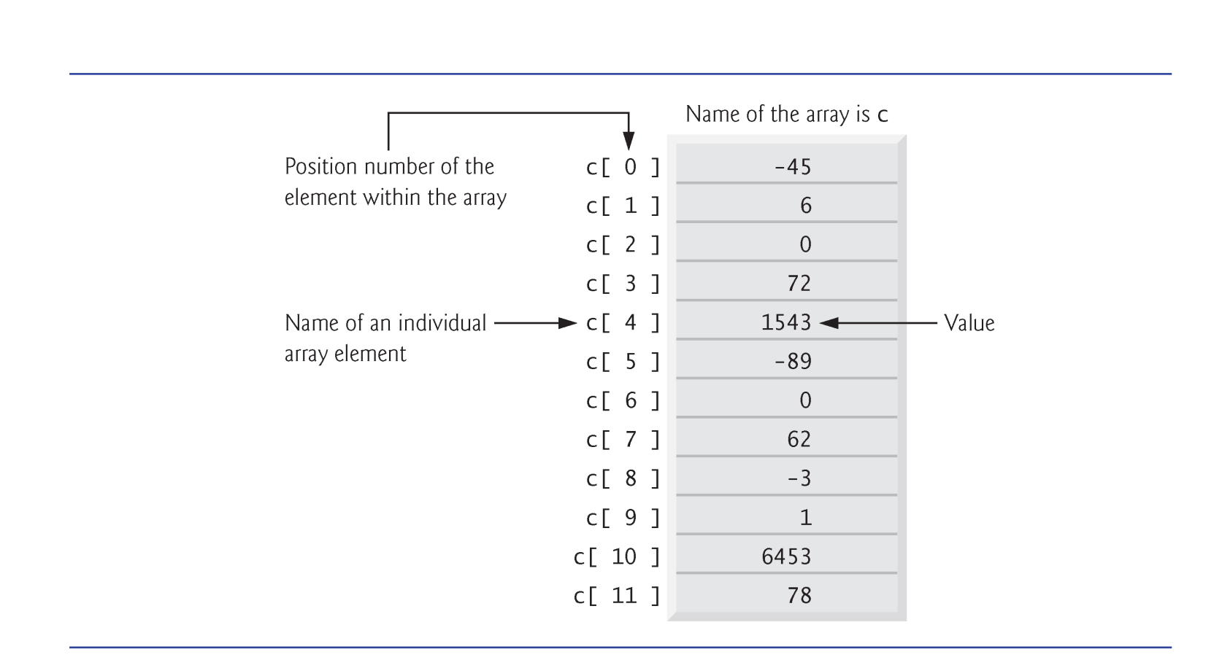
Memory Layout of Array

Slide 5
Declaring an Array
Arrays occupy space in memory.
To specify the type of the elements and the number of elements required by an array use a declaration of the form:
type arrayName[ arraySize ];
Ex: int n[5]; → 5 integer elements
The compiler reserves the appropriate amount of memory.
All elements are put in a continuous memory space.

Slide 6
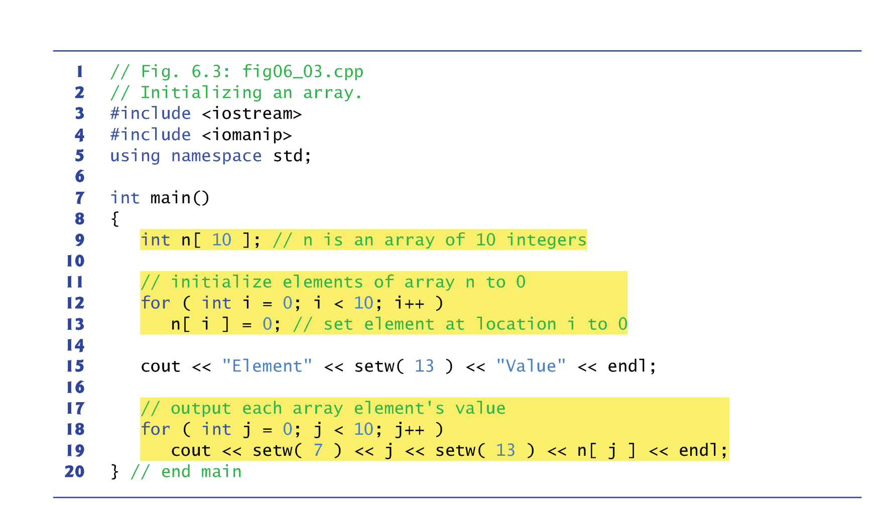
Array Example

Slide 7
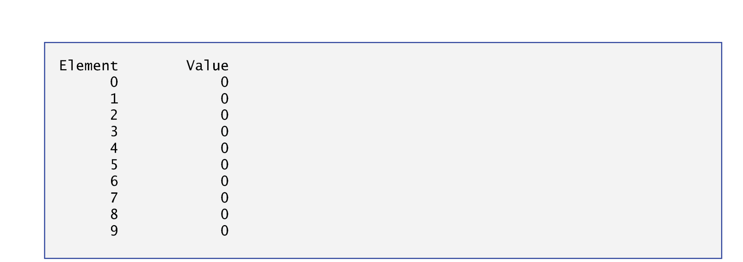
Array Example

Slide 8
Search an Item in an Array
Often it may be necessary to determine whether an array contains a value that matches a certain key value.
Called searching.
The linear search compares each element of an array with a search key.
Because the array is not in any particular order, it’s just as likely that the value will be found in the first element as the last.
On average, therefore, the program must compare the search key with half the elements of the array.
To determine that a value is not in the array, the program must compare the search key to every element of the array.

Slide 9
Example 1
Input:
A std::vector vec of integer numbers
An integer number v
Output
“Yes”, if v can be found in vec
“No”, if v cannot be found in vec

Slide 10
Example 2: Maximum Subarray Sum Problem
Given a sequence of integer number, find the largest sum of contiguous array numbers
Notes:
The next example I am going to talk about is the maximum subarray sum problem. This is also another famous example of divide and conquer. Given a ...
That is, you are given a one dimensional array that may contain both positive and negative integers, find the sum of contiguous subarray of numbers which has the large sum. For example, if the array is -2, -3, ... etc, then the maximum subarray sum is 7.
Why is this problem important?

Slide 11
Practical Application
A basic routine of financial computing
Maximum subarray sum to find the optimal long-term investment
Notes:
Well, this is in fact a question I was asked by a financial company when I took an interview. If you look at stock market, the price over time changes a lot, right. It can go very low today, and become very high tomororw or next week, or even wihin the next couple hours.
If you look at a short-term investment, you always want to find a contiguous range that produces the maximum sum within a time period (of course, it has to be contigious because you buy the stock and then sell it, there is no other options)
So the problem is alwasy modelled as a sequence of numbers, positive and negative, potentially very large, and you want to quickly compute the largest subarray sum. And that gives you the best profit you may get in that certain period.

Slide 12
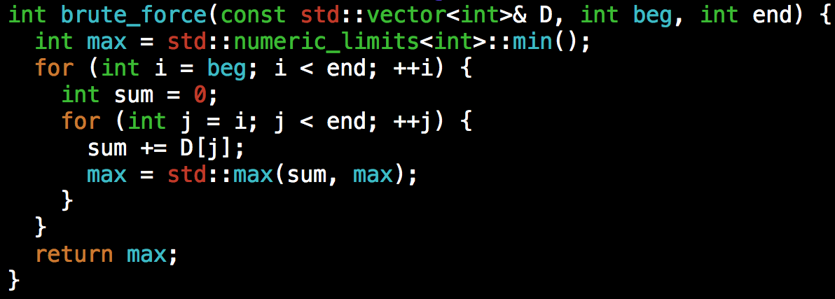
Debrief
The solution we presented has two-level loops
At worst, you need N² iterations, where N is the size of the input array
Can we do better?
Notes:
Now, let's go back to the problem itself.
Again, we always start with the simple approach, even though it is slow. At least you need to be able to find the solution first before you can improve it.
Any idea?
(click) The naive method is to run two loops. The outer loop picks the beginning element, the inner loop finds the maximum possible sum with first element picked by outer loop and compares this maximum with the overall maximum. Finally return the overall maximum. The time complexity of the Naive method is O(n^2).

Slide 13
Sorting
The most fundamental algorithm in all subjects …
Goal: puts elements in a certain order
Increasing order: 1, 2, 5, 6, 8, 90, 123
Decreasing order: 123, 90, 8, 6, 5, 2, 1
Many algorithm paradigms
Bubble sort
Selection sort
Merge sort
Qsort
…
Today, new sorting algorithms are being invented
Notes:
Then next topic we are going to talk about is sorting. As you can imagine, sorting is the most fundamental algorithm in all computer science and computer engineering subjects. The goal is to put elements in a certain order, often increasing order or decreasing order.
(explain)

Slide 14
Selection Sort
Two loops
Outer loop to repeat n-1 times
Inner loop to find the minimum element
Notes:
Selection sort is one of the simplest methods in the sorting area. The idea is to iteratively scan the sequence of numbers and pick up the number with the minimum or maximum value. That means you will have two loops. The outer loop repeat n-1 times and the inner loop is to find the minimum element.
Intuition is, you need n steps to find the minimum over a sequence of n numbers, right? And how many times do you need in order to make everything sorted.
Explain.

Slide 15
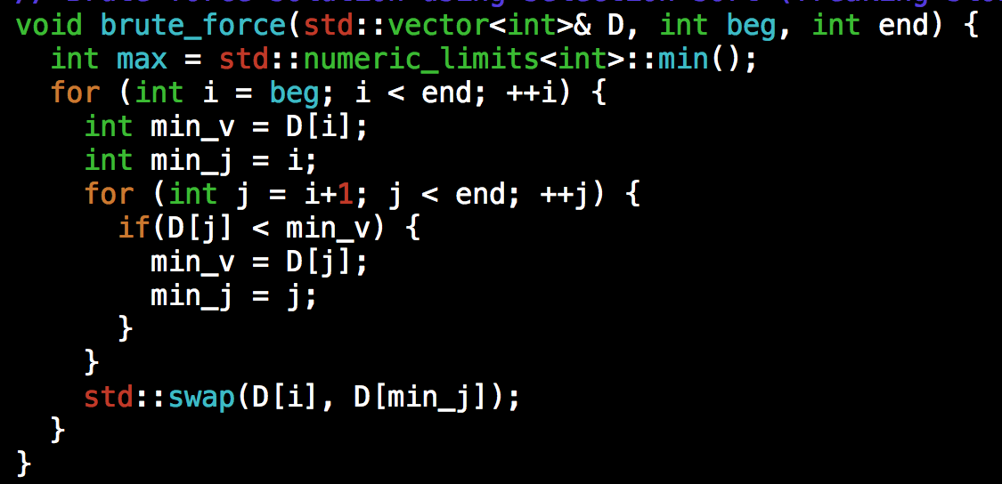
Selection Sort Implementation
Number of iterations N², or O(N²)

Slide 16
Using Divide and Conquer: Merge Sort
Divide: If S has at two or more elements (nothing needs to be done if S has zero or one elements), remove all the elements from S and put them into two sequences, S_{L} and S_{R}, each containing about half of the elements of S. (i.e. S_{L} contains the first ⎡n/2⎤ elements and S_{R} contains the remaining ⎣n/2⎦ elements.
Recurse: Recursively sort sequences S_{L} and S_{R}.
Conquer: Put back the elements into S by merging the two sorted sequences S_{L} and S_{R} into a sorted sequence.

Slide 17
Illustration
0
1
2
3
4
5
6
start
20
90
40
30
80
70
50
n = 7
mergesort(a, 0, 6)
1
11
mergesort(a, 0, 3)
mergesort(a, 4, 6)
0
1
2
3
4
5
6
20
90
40
30
80
70
50

Slide 18
Illustration
0
1
2
3
4
5
6
20
90
40
30
80
70
50
2
6
12
16
msort(a, 0, 1)
msort(a, 2, 3)
msort(a, 4, 5)
msort(a, 6, 6)
0
1
2
3
4
5
6
20
90
40
30
80
70
50
3
4
7
8
13
14
0
1
2
3
4
5
20
90
40
30
80
70

Slide 19
Illustration
0
1
2
3
4
5
6
20
90
40
30
80
70
50
5
9
15
0
1
2
3
4
5
20
90
30
40
70
80
10
17
0
1
2
3
4
5
6
20
30
40
90
50
70
80
18
0
1
2
3
4
5
6
20
30
40
50
70
80
90

Slide 20
Merge Sort Complexity
Run Time Analysis
At each level in the binary tree created for Merge Sort, there are n elements, with O(1) time spent at each element
O(n) running time for processing one level
The height of the tree is O(log n)
Therefore, the time complexity is O(nlog n)

Slide 21
Example 3: Merge Two Sorted Arrays
Input: Given two sorted arrays, L and R
Output: A merged, sorted array of L and R
Example:
L = {1, 2, 5, 6, 9}
R = { -5, -1, 0, 4, 19, 20 }
Output: {-5, -1, 0, 1, 2, 4, 5, 6,, 9, 19, 20}

Slide 22
Summary
Array
Maximum subarray sum
Commonly used in financial computing and VLSI designs
Sorting
Selection sort (kinda brute force: O(N²))
Merge sort (divide and conquer: O(nlogn))

